Slide 1
Weather Monitoring Wireless Sensor Network
University of Latvia
Ivans Dorohovs (id14016)
Toms Ozols (to11018)
Oļegs Pešudovs (op14002)
May Htoo Maung (m-14003)

Slide 2
Goal
To develop software for three different hardware parts:
Texas Instrument (for sensor node),
Arduino (for base station),
Raspberry PI (for base station).

Slide 3
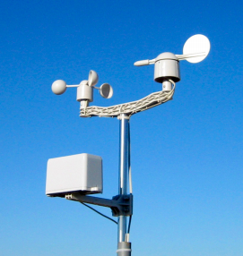
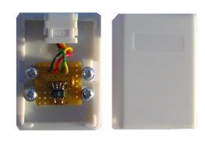
Sensors
Weather Meters, Rain Gauge, Wind Vane, Cup Anemometer
Temperature and Humidity sensor

Slide 4
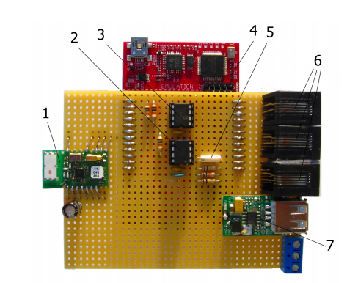
Sensor Node

Slide 5
Flow Chart For Sensor Node

Slide 6
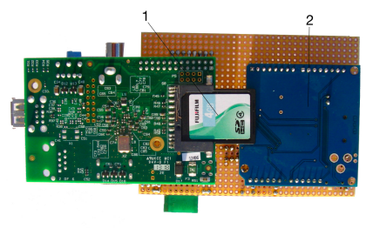
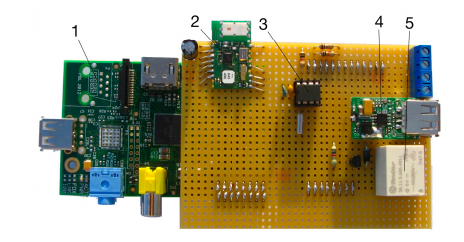
Base Station

Slide 7
Flow Chart For Arduino

Slide 8
Flow Chart For Raspberry PI

Slide 9
Thank you for your attention!

